Slide 1
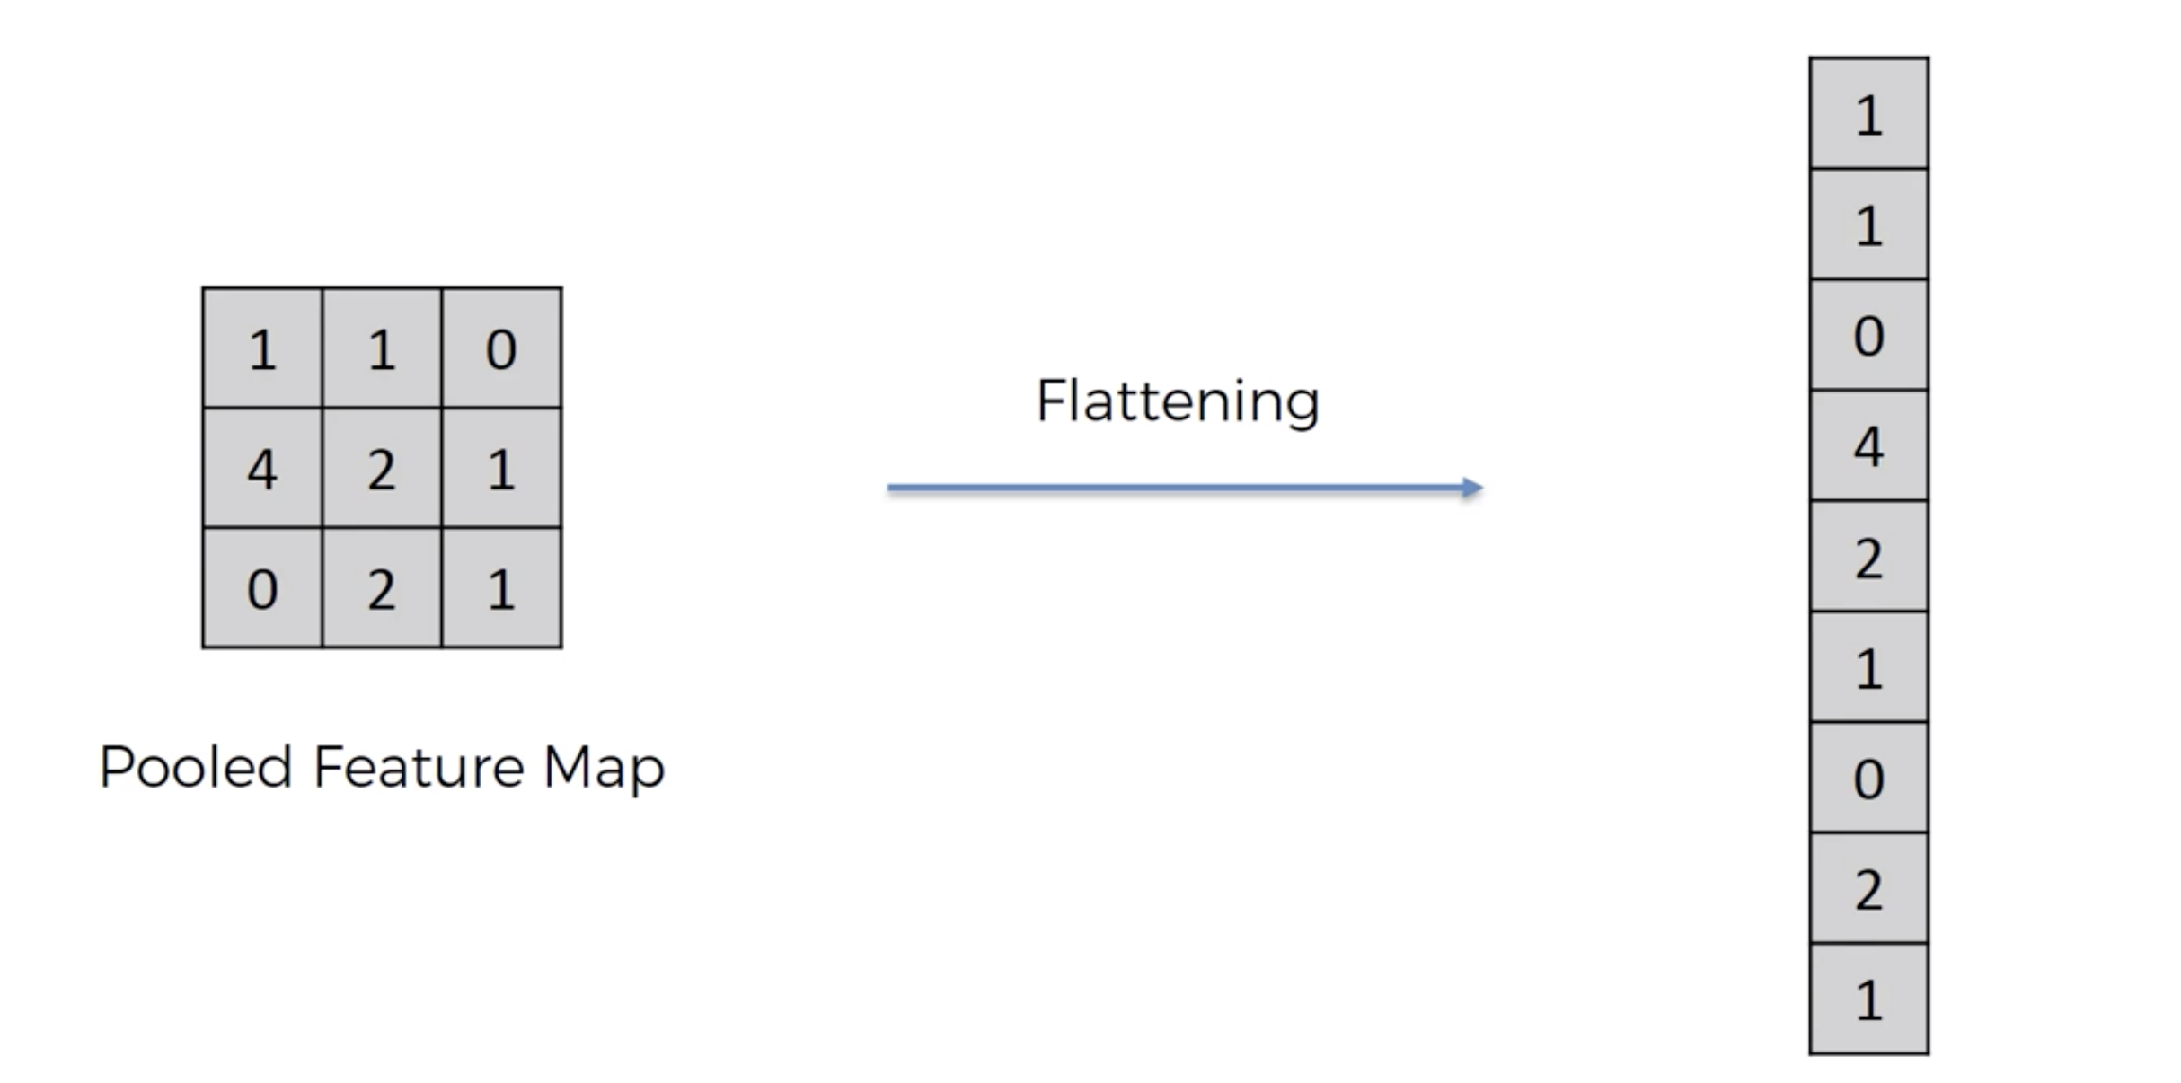
1
One big column with all max pooled maps flattened
2

Slide 2
+ReLU
+ReLU

